Slide 1
TK20431
C

Domain: Machine Learning
Technology: Python
<
ADVANCED PREDICTION OF PERFORMANCE OF A STUDENT IN AN UNIVERSITY USING MACHINE LEARNING TECHNIQUES

Slide 2
Index
Abstract
Introduction
Literature review
Existing Method
Drawbacks
Proposed method
Advantages
Implementation
Algorithms
Hardware and Software Requirements
Architecture
UML diagrams
Results
Conclusion
References

Slide 3
Abstract
Predicting academic performance is an important task for the students in university, college, and school, etc. Machine Learning is a field of computer science that makes the computer to learn itself without any help of external programs. These machine learning techniques can be used to predict the output for certain inputs. There are two approaches for machine learning techniques one is supervised learning and the other one is unsupervised learning. In unsupervised learning, K-means and Hierarchical clustering are being used and in supervised, Naïve Bayes and Decision Trees are used. Nowadays evaluating the student performance of any organization is going to play a vital role to train the students.

Slide 4
Introduction:
Student’s academic performance is a crucial part of an academic institution.
Predominantly, most of the higher level institutions use grade as the main measure to assess student’s performance.
In addition, course structure, student behavior and extracurricular activities will affect the student’s academic performance.
At present, machine learning algorithms are most popular to evaluate student’s academic performance that has been extensively applied in the education sector.
If students’ academic performance is predicted early, then extra effort can be taken to arrange proper support for the low performing students.

Slide 5
Literature review:
[1] Vairachilai S, Vamshidharreddy, “Student’s Academic Performance Prediction Using Machine Learning Approach”, IJAST, vol. 29, no. 9s, pp. 6731 - 6737, Jun. 2020.
This journal discusses about SVM and Naïve Bayes for students' performance prediction using students score/marks.

Slide 6
Literature review:
[2] Yassein, Nawal & Helali, Rasha & Mohomad, Somia. (2017). Predicting Student Academic Performance in KSA using Data Mining Techniques. Journal of Information Technology & Software Engineering. 07. 10.4172/2165-7866.1000213.
This journal introduced us with the concept of Data Mining and classification techniques. The specific objective of the proposed research work is to find out if there are any patterns in the available data (student and courses records) that could be useful for predicting students’ performance.

Slide 7
Literature review:
[3] Sharma, Himani & Kumar, Sunil. (2016). A Survey on Decision Tree Algorithms of Classification in Data Mining. International Journal of Science and Research (IJSR). 5.
In this paper, we learn about Decision Tree, types of Decision tree (ID3, C4.5, CART etc). It also discusses about the advantages and disadvantages of Decision Tree.

Slide 8
Literature review:
[4] Kaviani, Pouria & Dhotre, Sunita. (2017). Short Survey on Naive Bayes Algorithm. International Journal of Advance Research in Computer Science and Management. 04.
In this paper, we learn about Naïve Bayes, Bayes theorem, conditional probability. We also learn about the pros and cons of Naïve Bayes.

Slide 9
Literature review:
[5] Kaushik, Manju & Mathur, Bhawana. (2014). Comparative Study of K-Means and Hierarchical Clustering Techniques. International journal of Software and Hardware Research in Engineering. 2. 93-98.
In this paper, we learn clustering algorithms like Kmeans and Agglomerative clustering and their comparisons.

Slide 10
Existing method:
Earlier works involves using older Machine Learning algorithms like Logistic regression.
They suffer from very low accuracies.
There are Deep Learning based predictions as well which uses neural networks for prediction but they have high complexities and they fail to individually indentify the important features for prediction.

Slide 11
Disadvantages in Existing method:
Low accuracy.
High Variance.
Incurs bias in classification.
High Complexities.

Slide 12
Proposed method:
In our research & extensive literature survey, we found that Naïve Bayes works fine for Student's performance prediction a great accuracy but it can be further increased by other tree based algorithm like decision tree.
Decision tree, when tuned properly can generate significant increase in performance.
Also, we have used unsupervised and supervised learning methods combined.

Slide 13
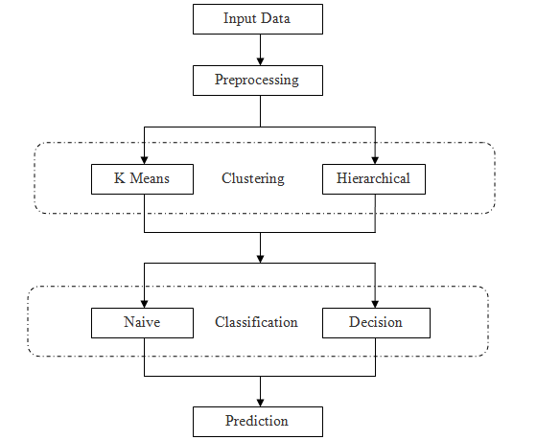

Slide 14
Advantages of Proposed method:
Higher Accuracy.
Low variance in classification.
Bias due to assumption about dataset are minimum or even nonexistent.
Low complexities.

Slide 15
Implementation
System:
Takes data.
Preprocessing.
Splitting Data.
Model Training.
Prediction.
User:
Upload Data.
View Data.
Input Test Size.
Model Testing.
Prediction.

Slide 16
Algorithms
K Means Clustering:
The algorithm will categorize the items into k groups of similarity.
To calculate that similarity, we will use the euclidean distance as measurement.
First we initialize k points, called means, randomly.
We categorize each item to its closest mean and we update the mean’s coordinates, which are the averages of the items categorized in that mean so far.
We repeat the process for a given number of iterations and at the end, we have our clusters.

Slide 17
Agglomerative Clustering:
It is a bottom up approach.
Is starts with many small clusters and merge them together to create bigger clusters.
This clustering algorithm does not require us to pre specify the number of clusters.
Bottom-up algorithms treat each data as a singleton cluster at the outset and then successively agglomerates pairs of clusters until all clusters have been merged into a single cluster that contains all data.

Slide 18
Naïve Bayes Classification:
Naïve Bayes classifiers are a collection of classification algorithms based on Bayes Theorem.
We assume that no pair of features are dependent. Hence, the features are assumed to be Independent.
Secondly, each feature is given the same influence(or importance). So none of the attributes are irrelevant and assumed to be contributing Equally to the outcome.

Slide 19
Decision Tree:
A Decision tree is a flowchart like tree structure.
Each internal node denotes a test on an attribute.
Each branch represents an outcome of the test.
Each leaf node (terminal node) holds a class label.
An instance is classified by starting at the root node of the tree, testing the attribute specified by this node, then moving down the tree branch corresponding to the value of the attribute.
Gini method or Information Gain (entropy) is used for attribute selection.

Slide 20
Hardware and Software Requirement:
Python v3.6+
PyCharm IDE.
RAM: 4GB minimum.
Processor: I3 (min)
Hard Disk: 128 GB +
OS: Windows 7+

Slide 21
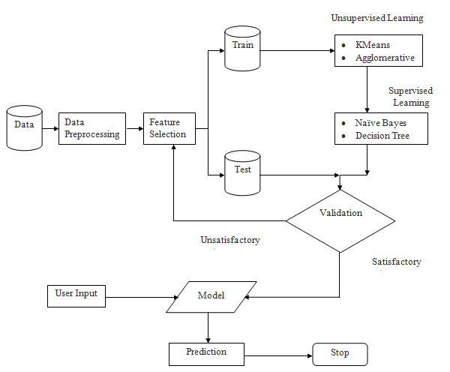
Architecture

Slide 22
Use Case Diagram
A use case diagram in the Unified Modeling Language (UML) is a type of behavioral diagram defined by and created from a Use-case analysis. Its purpose is to present a graphical overview of the functionality provided by a system in terms of actors, their goals (represented as use cases), and any dependencies between those use cases. The main purpose of a use case diagram is to show what system functions are performed for which actor. Roles of the actors in the system can be depicted.

Slide 24
Class Diagram
In software engineering, a class diagram in the Unified Modeling Language (UML) is a type of static structure diagram that describes the structure of a system by showing the system's classes, their attributes, operations (or methods), and the relationships among the classes. It explains which class contains information.

Slide 25
Sequence Diagram
A sequence diagram in Unified Modeling Language (UML) is a kind of interaction diagram that shows how processes operate with one another and in what order. It is a construct of a Message Sequence Chart. Sequence diagrams are sometimes called event diagrams, event scenarios, and timing diagrams.

Slide 27
Collaboration Diagram
In collaboration diagram the method call sequence is indicated by some numbering technique as shown below. The number indicates how the methods are called one after another. We have taken the same order management system to describe the collaboration diagram. The method calls are similar to that of a sequence diagram. But the difference is that the sequence diagram does not describe the object organization where as the collaboration diagram shows the object organization.

Slide 29
Deployment Diagram
Deployment diagram represents the deployment view of a system. It is related to the component diagram. Because the components are deployed using the deployment diagrams. A deployment diagram consists of nodes. Nodes are nothing but physical hardware used to deploy the application.

Slide 30
Activity Diagram
Activity diagrams are graphical representations of workflows of stepwise activities and actions with support for choice, iteration and concurrency.
In the Unified Modeling Language, activity diagrams can be used to describe the business and operational step-by-step workflows of components in a system.
An activity diagram shows the overall flow of control.

Slide 32
Component Diagram
A component diagram, also known as a UML component diagram, describes the organization and wiring of the physical components in a system. Component diagrams are often drawn to help model implementation details and double-check that every aspect of the system's required functions is covered by planned development.

Slide 33
Results
In this application, we have pre processed the data by removing the null values and encoding all the variables.
KMeans clustering and Agglomerative clustering are the 2 clustering algorithms which we have used here.
Naïve Bayes and Decision Tree are the 2 supervised algorithms used for actual classification of the students performance.
Hyperparameter tuning was done for Decision Tree.

Slide 34
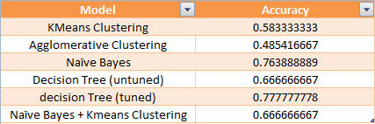
Comparisons:
The accuracies (test) of all the models is shown below:

Slide 35
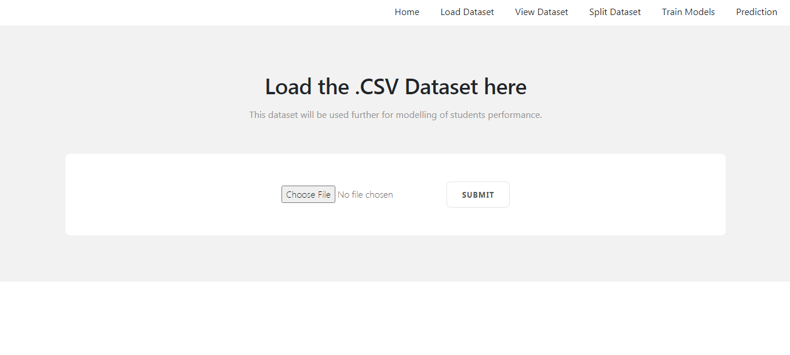

Slide 36
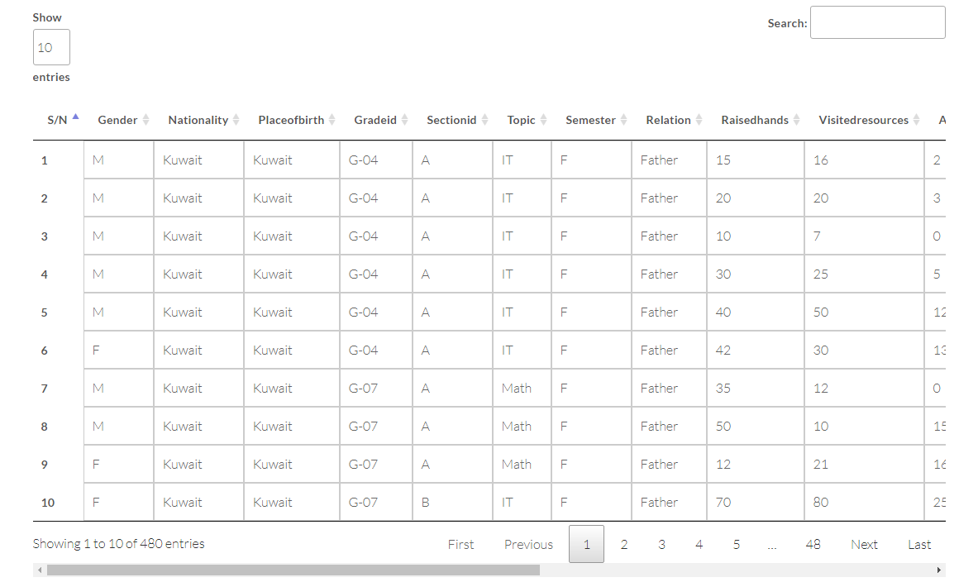

Slide 37
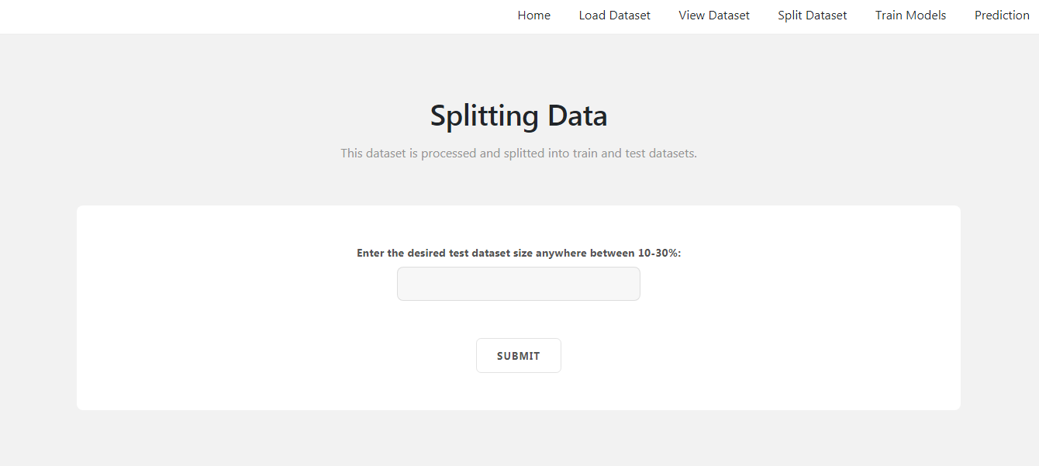

Slide 38
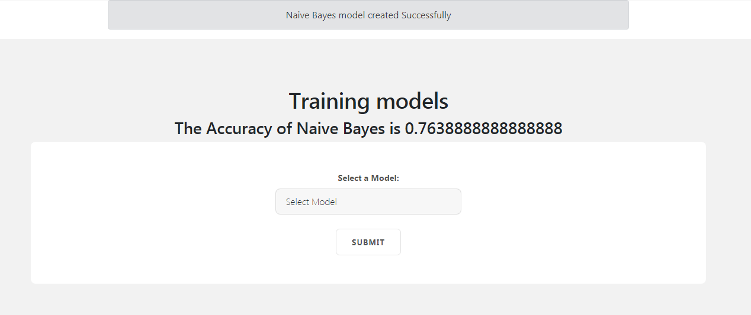

Slide 39
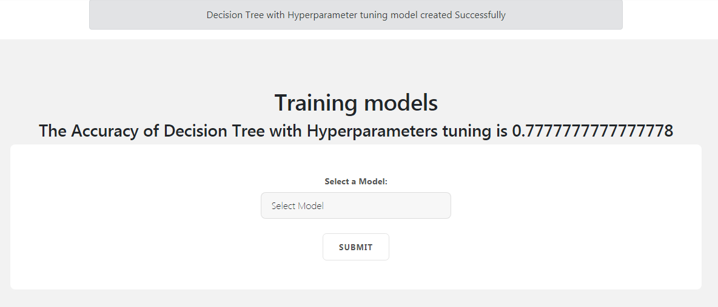

Slide 40
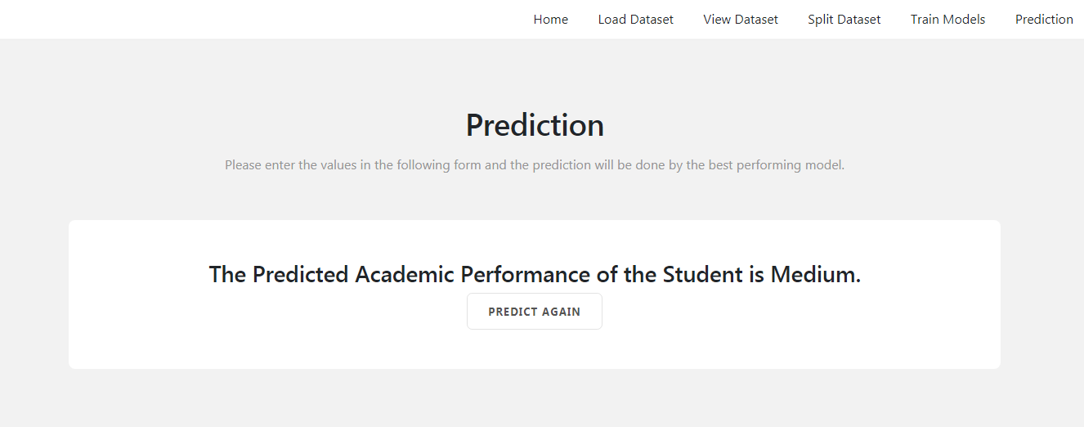

Slide 41
Conclusion:
We have used GridSearchCV for Hyperparameters tuning for Decision Tree.
Then we used the machine learning models – Kmeans Clustering, Agglomerative Clustering, Naïve Bayes and Decision Tree.
We have also combined supervised and unsupervised models.
We can observe that Decision Tree, when its Hyper parameters are tuned gives the best results.
Tuned Decision Tree is used for prediction of students’ performance.

Slide 42
References:
[1] Vairachilai S, Vamshidharreddy, “Student’s Academic Performance Prediction Using Machine Learning Approach”, IJAST, vol. 29, no. 9s, pp. 6731 - 6737, Jun. 2020.
[2] Yassein, Nawal & Helali, Rasha & Mohomad, Somia. (2017). Predicting Student Academic Performance in KSA using Data Mining Techniques. Journal of Information Technology & Software Engineering. 07. 10.4172/2165-7866.1000213.
[3] Sharma, Himani & Kumar, Sunil. (2016). A Survey on Decision Tree Algorithms of Classification in Data Mining. International Journal of Science and Research (IJSR). 5.
[4] Kaviani, Pouria & Dhotre, Sunita. (2017). Short Survey on Naive Bayes Algorithm. International Journal of Advance Research in Computer Science and Management. 04.

Slide 43
[5] Kaushik, Manju & Mathur, Bhawana. (2014). Comparative Study of K-Means and Hierarchical Clustering Techniques. International journal of Software and Hardware Research in Engineering. 2. 93-98.
[6] Verma K, Singh A, Verma P (2016) A review on predicting students performance using data mining techniques. IJCESR 3: 127-132.
[7] Baker, Ryan SJD, Yacef K (2009) The state of educational data mining in 2009: A review and future visions. JEDM 1: 3-16.
[8] Altaher A, BaRukab O (2017) Prediction of student's academic performance based on adaptive neuro-fuzzy inference. IJCSNS 17: 165-169.

Slide 44
[9]. Kabakchieva D (2012) Student performance prediction by using data mining classification algorithms. IJCSMR 1: 686-690.
[10]. Agaoglu M (2016) Predicting instructor performance using data mining techniques in higher education.
[11]. Ramesh V, Parkavi P, Ramar K (2013) Predicting student performance: A statistical and data mining approach. IJCA 63: 35-39
[12] R. R. Kabra,R. S. Bichkar, “Performance Prediction of Engineering Students using Decision Trees”, International Journal of Computer Applications (0975 – 8887), Volume 36– No.11, December 2011

Slide 45
[13] Ajay Kumar Pal, Saurabh Pal, “Data Mining Techniques in EDM for Predicting the Performance of Students”, International Journal of Computer and Information Technology (ISSN: 2279 – 0764),Volume 02– Issue 06, November 2013
[14] Abeer Badr El Din Ahmed1, Ibrahim Sayed Elaraby, “Data Mining: A prediction for Student's Performance Using Classification Method”, World Journal of Computer Application and Technology 2(2): 43-47, 2014, DOI: 10.13189/wjcat.2014.020203

